Slide 1

Cross-talk attack
on Rigetti quantum computer
Presenters: He Xie, Adriana Aranguren
Comp_Eng 395
Date: 06.05.2025

Slide 2

Background
Cross-Talk in Quantum Computers
When multiple qubits perform gates simultaneously, unintended interactions (“cross-talk”) can introduce errors in neighboring qubits.
Cross-talk arises due to residual coupling between physical qubits, imperfect isolation, and limitations in hardware design.
These errors are especially severe when running large or parallel quantum circuits, as simultaneous operations increase the risk of interference.
Cross-talk can cause:
Loss of quantum coherence (decoherence)
Unintended entanglement or unwanted correlations between qubits
Distortion of expected measurement outcomes, making computations unreliable

Slide 3
Project Objectives
Evaluate the impact of a new cross-talk (rowhammer-style) attack on the Rigetti Ankaa-3 quantum computer using qBraid.
Design and implement the attack
Run a dense CNOT circuit on attacker qubits while the victim circuit executes on neighboring qubits.
Measure and compare:
Collect output distributions from the victim circuit both alone and under attack.
Assess how the attacker affects the victim’s computation fidelity.
Analyze scalability:
Vary attacker strength and victim size to quantify how cross-talk error scales.
Goal: Demonstrate and visualize how much a cross-talk attack can disrupt quantum computation.

Slide 4
Experimental Procedure
Step 1: Select Victim Circuit
Choose a quantum circuit as the victim (here: ising_n10 from QASMBench, 10 qubits).
Step 2: Run Baseline Simulation
Execute the victim circuit alone, without attackers.
Collect and record the measurement output distribution (counts of each bitstring).
This serves as the baseline reference.

Slide 5
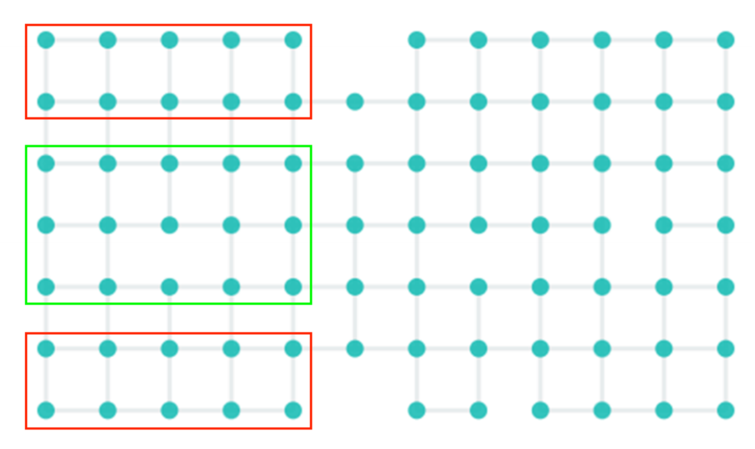
Step 3: Construct Cross-Talk Attack
Design two attacker circuits: one above and one below the victim circuit.
Insert the victim circuit between the two attackers (sandwiched layout) to simulate cross-talk.
Step 4: Run Attack Simulation
Execute the combined “sandwiched” circuit (attacker1 + victim + attacker2).
Collect and record the new measurement output distribution.
Rigetti Systems Ankaa-3 Quantum Processor
Step 5: Data Analysis and Visualization
Compare the bitstring distributions from baseline and attack.
Visualize the results (bar charts, probability tables).
Quantify the difference in output patterns before and after attack.

Slide 6
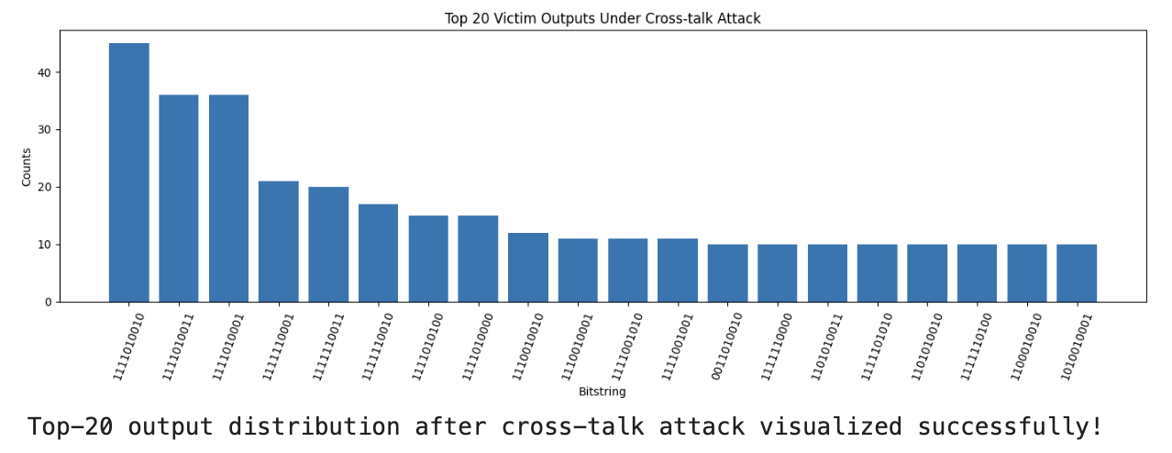
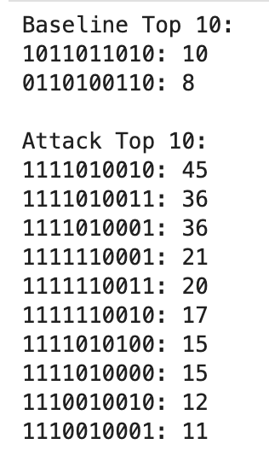
Data Analysis

Slide 7

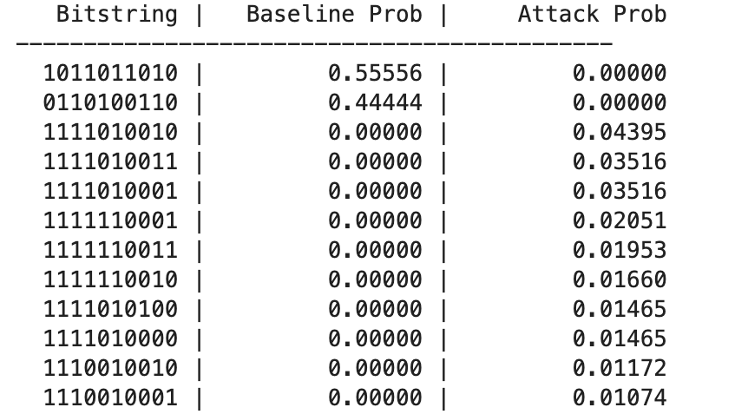
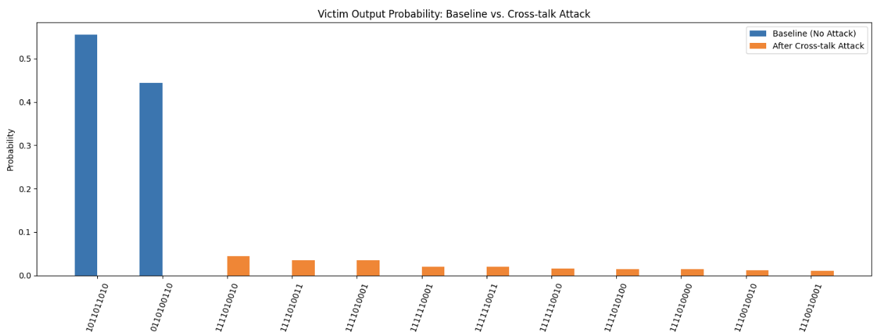
Comparison

Slide 8
Conclusion
Cross-talk attacks can severely disrupt quantum computations on near-term hardware.
Our experiments show that the victim circuit’s correct outputs disappear entirely under attack, replaced by many low-probability “random” results.
This demonstrates that even without direct access to the victim’s qubits, a strong attacker can destroy computational fidelity just by running dense operations in parallel.

Slide 9
Reference:
QASMBench:https://github.com/pnnl/QASMBench

Slide 10
Thank you !

